Slide 1
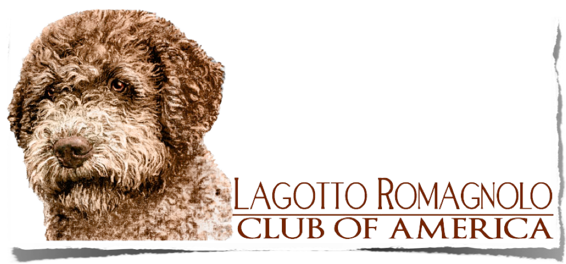
REVISED STANDARD EFFECTIVE 3/31/2020

Slide 2
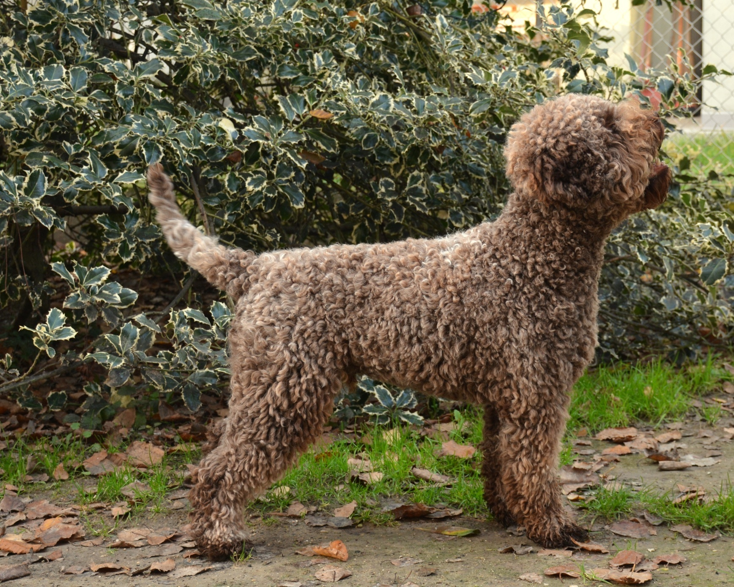
Judges Education Seminar
Lagotto Romagnolo
Slide Show Information assembled by the LRCA Judge’s Education Committee
Illustrations by Laurin Howard and Giovanni Morsiani

Slide 3
A LAGOTTO IS...

Slide 4
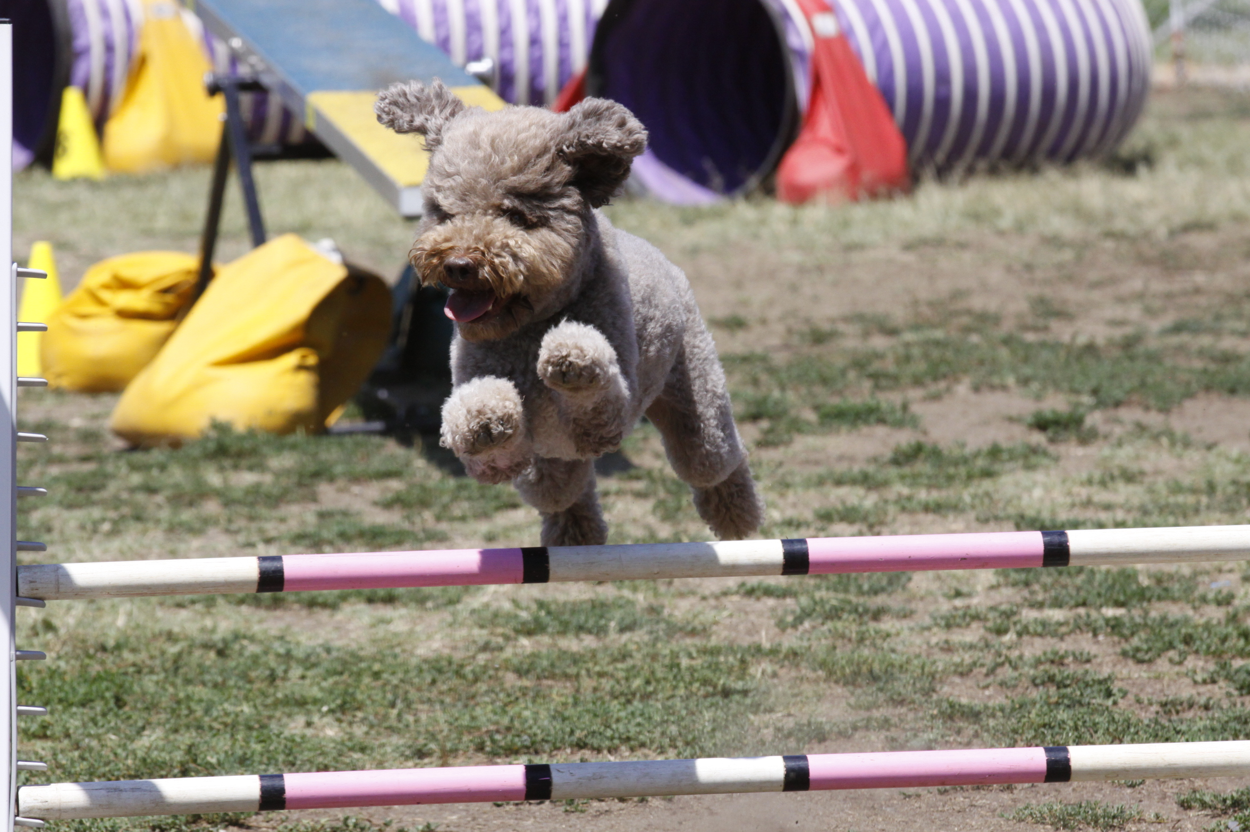
FAST AND BIDDABLE

Slide 5
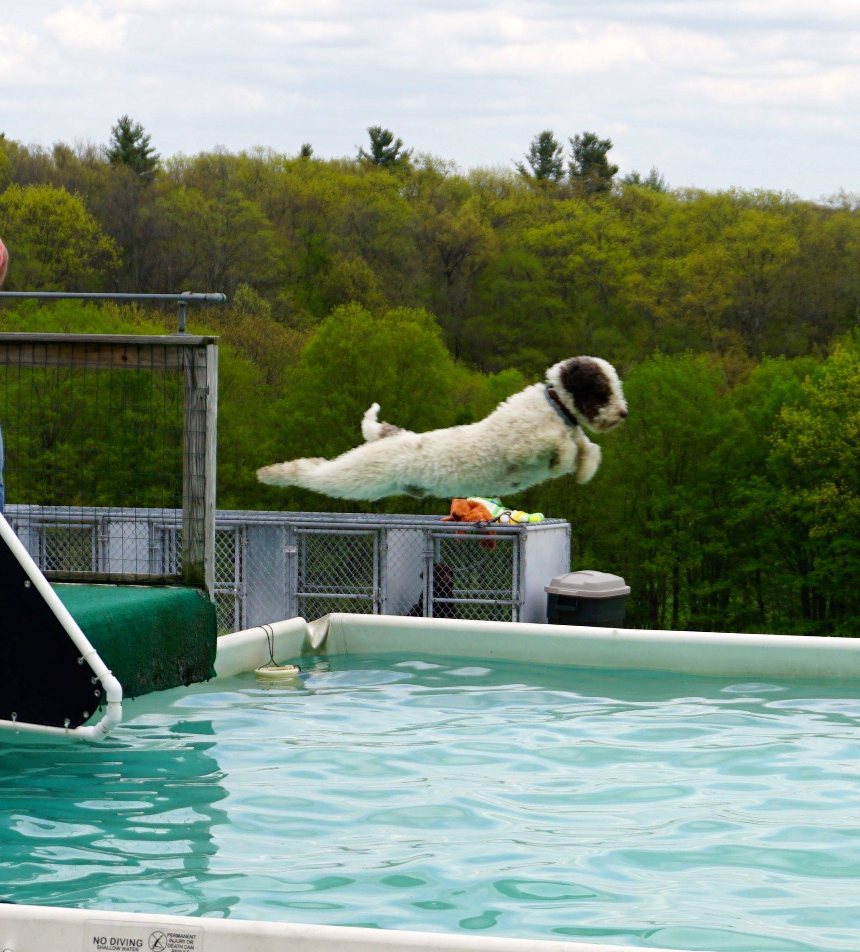
WATER LOVING

Slide 6
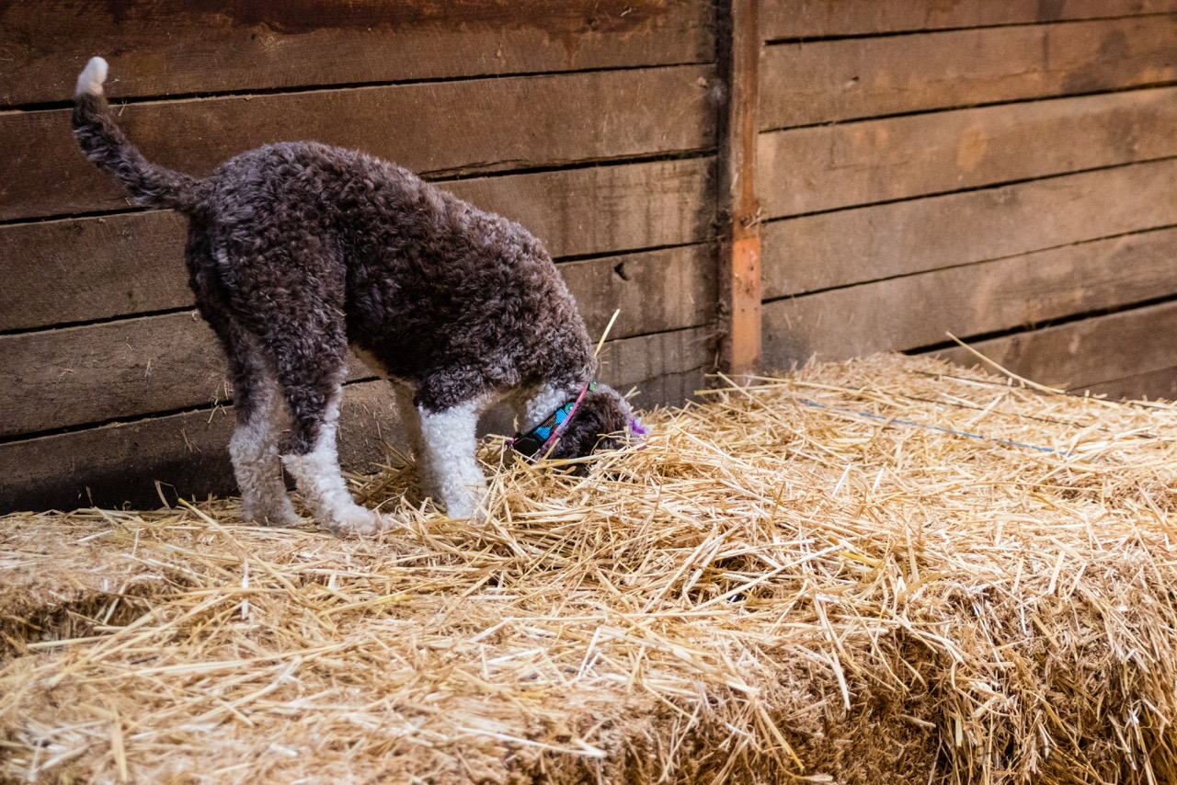
AND THEY LOVE TO USE THEIR NOSE…

Slide 7
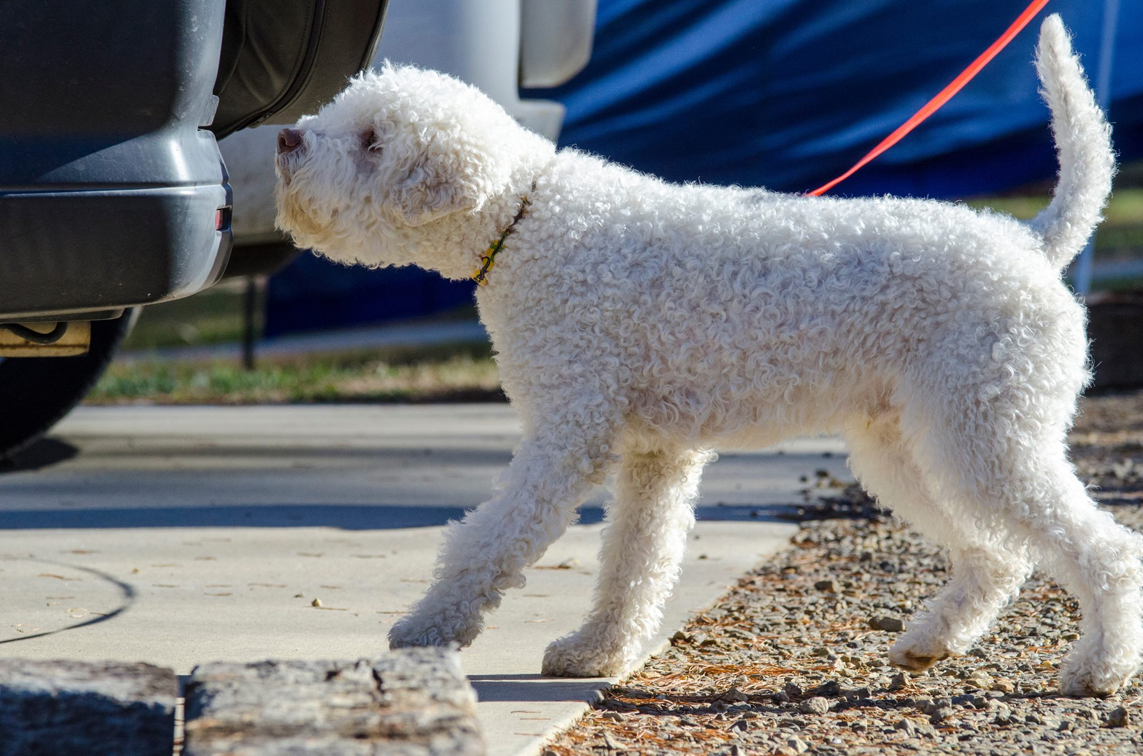
IN A VARIETY OF SCENT WORK DISCIPLINES

Slide 8
Part one:
Look at the early history which includes the two careers of the dog: water fowl retriever to truffle hunter.
Examine how the Lagotto’s second career influenced the changes from a more traditional sporting dog to a master of scent and a hunter of fungi!
Explore the practical reasons that the Lagotto is the ideal dog for maximum efficiency in truffle hunting as well as being more eco friendly.
Then we’ll take a break and come back and look at the hallmark characteristics of the breed in Part Two

Slide 9
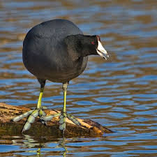
Lagotto Romagnolo were originally water fowl retrievers, possibly the first of the curly coated water retrievers.
Originally used on game, they are enjoying a second career as the world’s foremost hunter of truffles. They are now the only dog in the Sporting Group not eligible for hunting tests.
Attributes of their FIRST CAREER:
Swam next to the shallow boats in the marshlands of Romagna all day long,
Small enough to be scooped up and put into the boat to go home.
Especially good on hunting coot
Water proof coat
Webbed feet
Energy to work all day

Slide 10
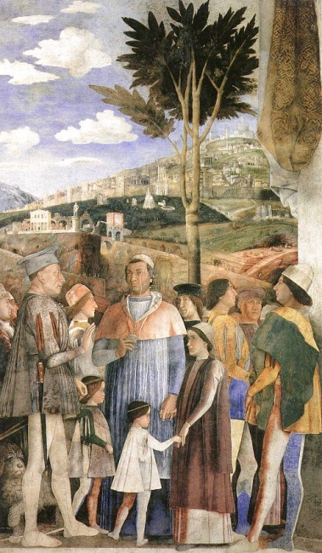
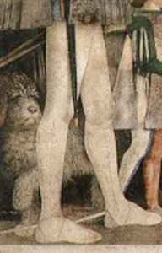
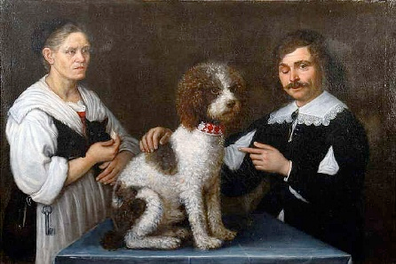
Historical Summary
Ancient breed of retrieving water dogs found in the lowlands of Comacchio and marshlands of Ravenna, in Italy. During the centuries, the great marshlands were drained and turned into arable land. Subsequently the Lagotto changed from being a water dog to an excellent dog for searching for truffles in the flat open country and in the hills of Romagna, a job that it performs with passion and efficiency.
Notes:
Early paintings from the Renaissance show the Lagotto featuring prominently in Italian life. If he is truly the oldest of the water dogs, it is probably during the spread of Renaissance ideas throughout Europe that the Lagotto also was carried far and wide where the breed was further developed in it’s new homelands. This gives rise to the Barbet (French Water Dog), the Spanish Water Dog, the Portuguese Water Dog, and the German Water Dog (poodle).

Slide 11
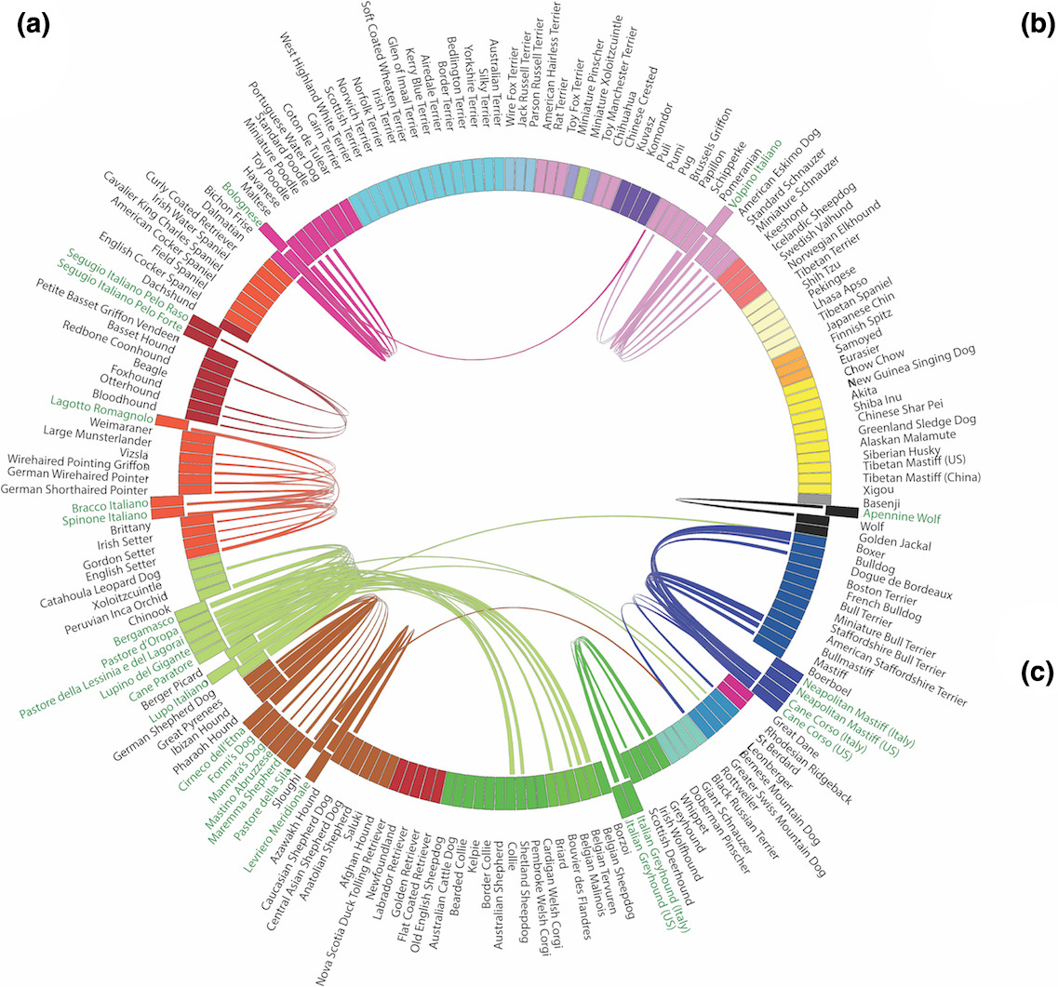
HOWEVER…
Notes:
The LRCA was approached by a researcher at the Human Genome Project in 2016. They were doing a project on rare Italian Breeds. After collecting DNA from dogs we were surprised to find out that we weren’t related to the dog breeds that we thought we were. A strong influence from both the English Setter and the Spinone Italiano were noted…and we grouped genetically with upland game dogs not the water retrievers.

Slide 12
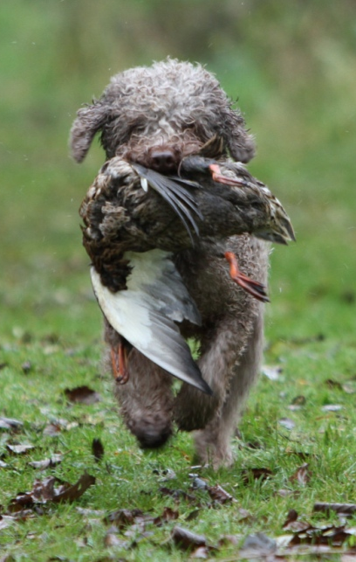
Coot hunters to Truffle Dogs
[Over] several decades…..[the] Lagotto Romagnolo also gradually lost its function of water dog and specialized gradually as a truffle dog. The transition between these two functions ranges between 1840 and 1890. One can even affirm that during the time between the two world wars, almost all of the truffle dogs of the truffle hunters of Romagna and the adjacent areas were Lagotto Romagnolo. In subsequent decades the use of concrete pylons to support grapevines and the steady disappearance of woodland has made the truffle a somewhat rarer find, especially on the plain. The Lagotto Romagnolo then turned out to be the perfect choice for searching in hilly woodland and thorny scrub during the autumn-winter period on account of its tightly-knit coat. Dr. Giovanni Morsiani, Short History of the breed and current situation
Notes:
Only in England is the dog still actively “shot over”, this was originally meant to make sure that the dog maintained it’s working ability in areas of the world where truffles are scarce or non-existent. Recently, however, the Lagotto Romagnolo Club of Great Britain just held a truffle hunting seminar.

Slide 13
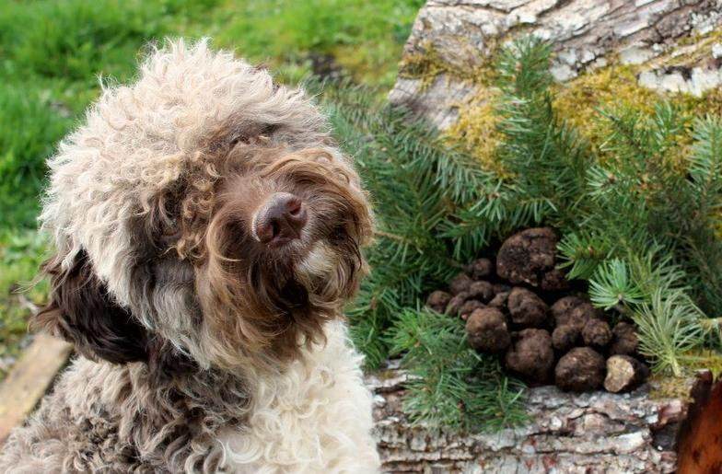
Did you say Truffles?
“The black magic apple of love”…..…..George Sand

Slide 14
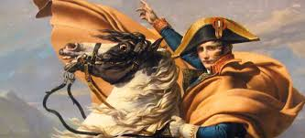
MAGICAL AND MEDICINAL POWERS OF TRUFFLES
NAPOLEAN AND THE MARQUIS DE SADE ARE REPUTED TO HAVE USED THEM AS A SEXUAL STIMULANT
PRIESTS AND NUNS ARE WARNED THAT THE CONSUMPTION OF TRUFFLES WAS INCONSISTENT WITH A VOW OF CHASTITY
TRUFFLE WATER USED AS A TREATMENT FOR THE EYE
TREATMENT FOR WEAKNESS, VOMMITTING, PAINS AND HEALING WOUNDS
FOR STRENGTH (WHEN MADE INTO A SYRUP)
TO TREAT GOUT
AS AN APHRODESIAC

Slide 15
TRUFFLE FACTS:
Truffles are found under ground, on the roots of trees as much as 24” below the surface
Dogs will only indicate on ripe truffles
Truffles are found everywhere----BUT not all truffles are valuable culinary ingredients
Can be found in the forest or in cultivated orchards. These orchards can produce an alternate crop as well (e.g. pecans)
Up to 24”
Notes:
This slide is hard to read for the audience in a big room.

Slide 16
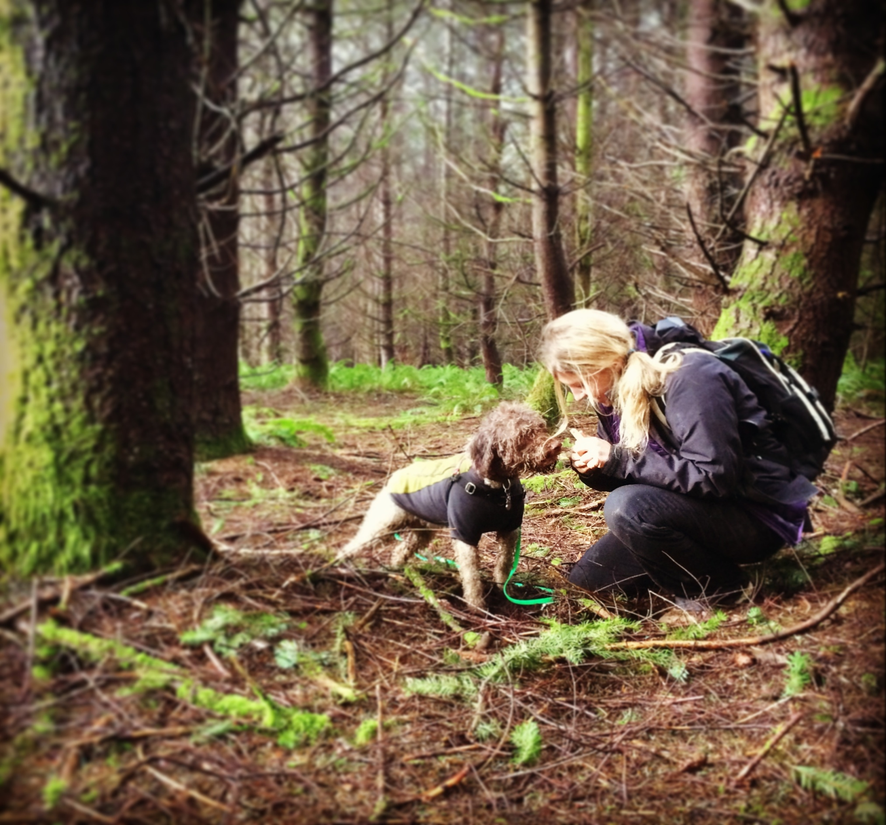
HUNTING IN THE FOREST OR IN THE COMMERCIAL TRUFFIERE

Slide 17
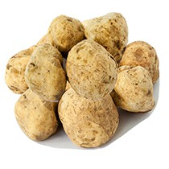
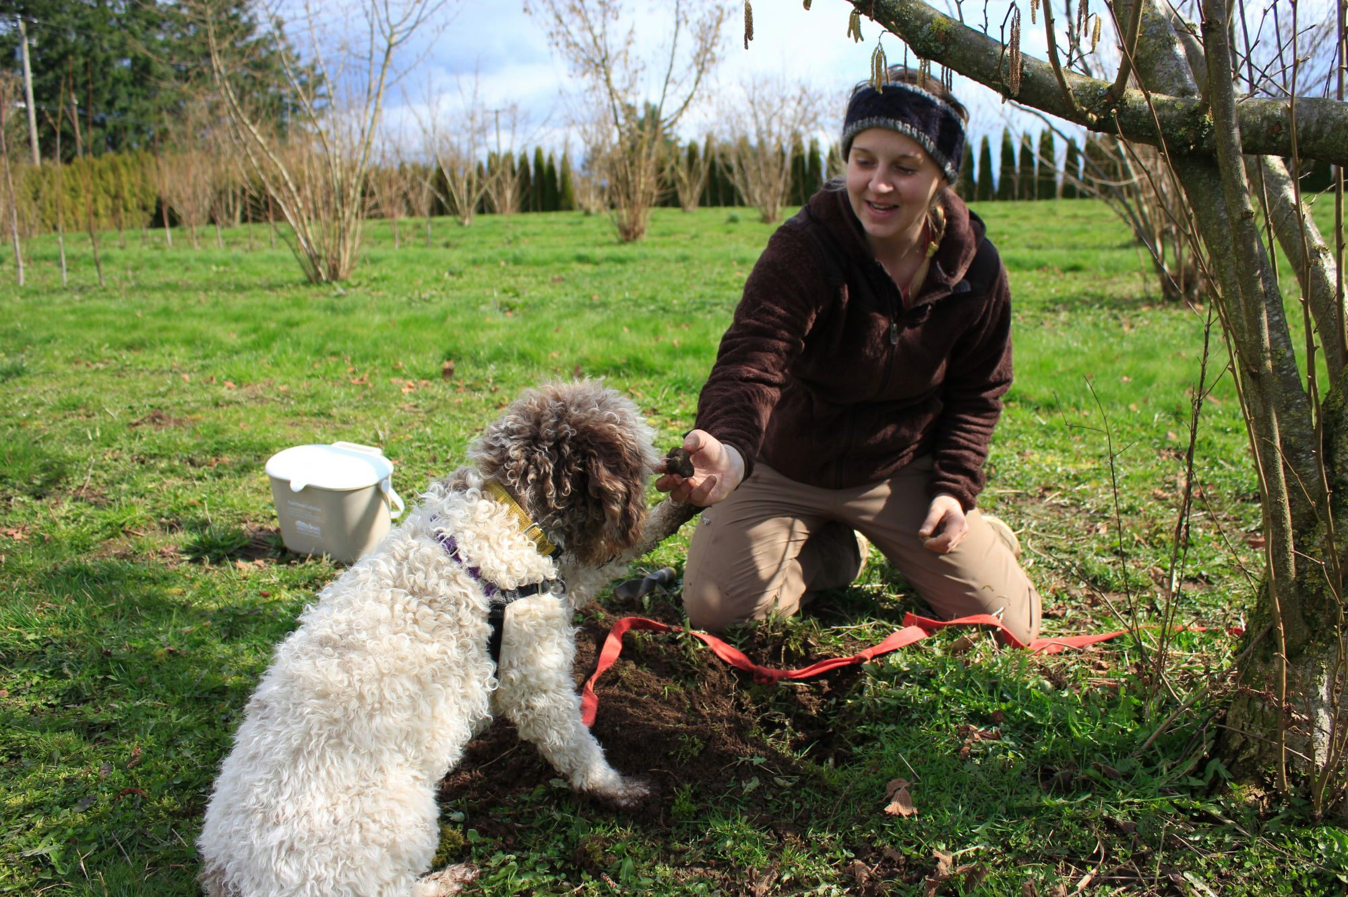
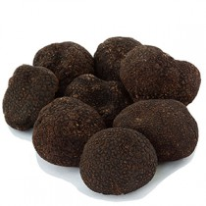
Truffle Economics
Fresh White truffles 4 oz $965
Fresh Black Winter Truffles 4 oz $295
AND
FREE SHIPPING!!!!
Current prices taken from the Urbani Truffles website 12/15
Notes:
Making the point that a duck is dinner, but hunting truffles is a livelihood for a family. Hunting truffles is much more lucrative. One acre of truffles can produce an income of $63,000 an acre of a wine orchard typically produces $18,000 income.

Slide 18
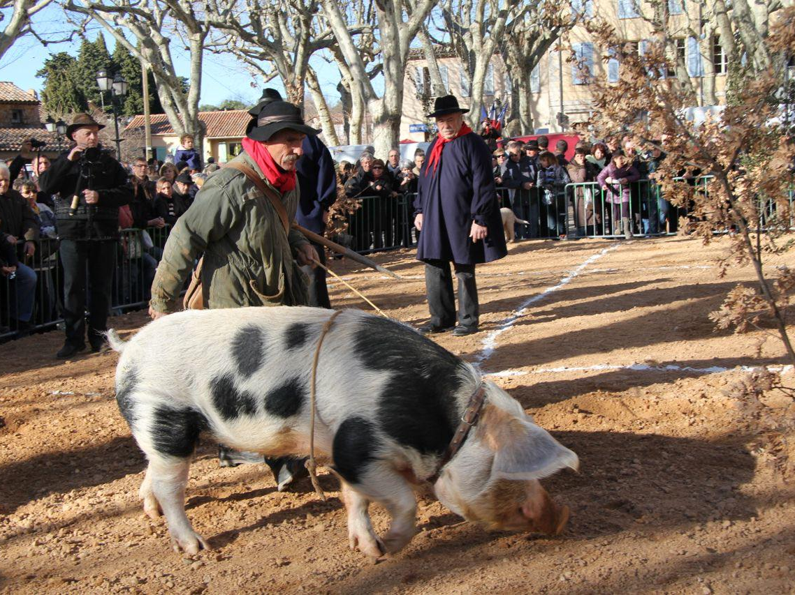
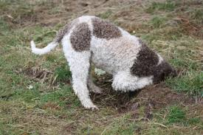
PIG VS. DOG
PIGS: DOGS:
Superior Natural Truffle Hunters More energy for the hunt
Natural interest Can be trained
They bite! More Biddable AND…..
LESS CONSPICUOUS TO POACHERS THAN TAKING A PIG FOR A WALK!
Notes:
The number one reason that the dog is better is because the truffle hunter can go to his/her area with less notice being taken by a poacher.

Slide 19
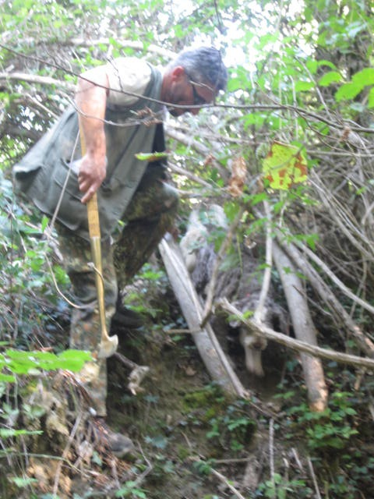
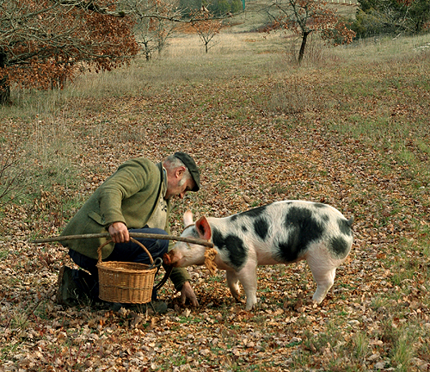
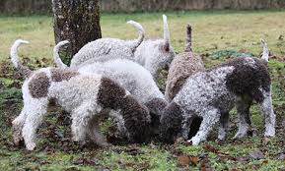
Because truffles are such a valuable harvest
Areas where they are found are kept secret
may be passed down through generations
Hunting birds does not have the same profit
Poachers have been known to:
steal truffle dogs,
poison truffle dogs,
steal truffles from commercial truffieres

Slide 20
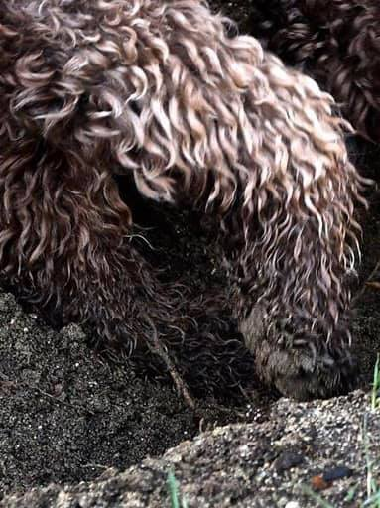
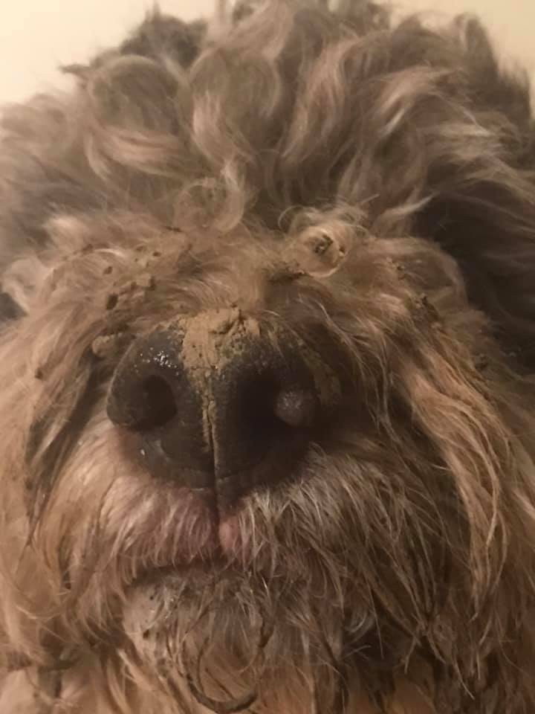
TRUFFLE TOOLS
Notes:
Both the dog’s attributes, strong feet for digging and large nose with wide open nostrils are tools for successful truffle hunting.

Slide 21
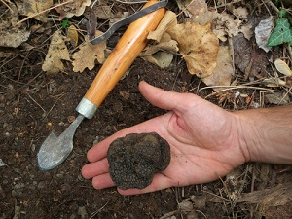
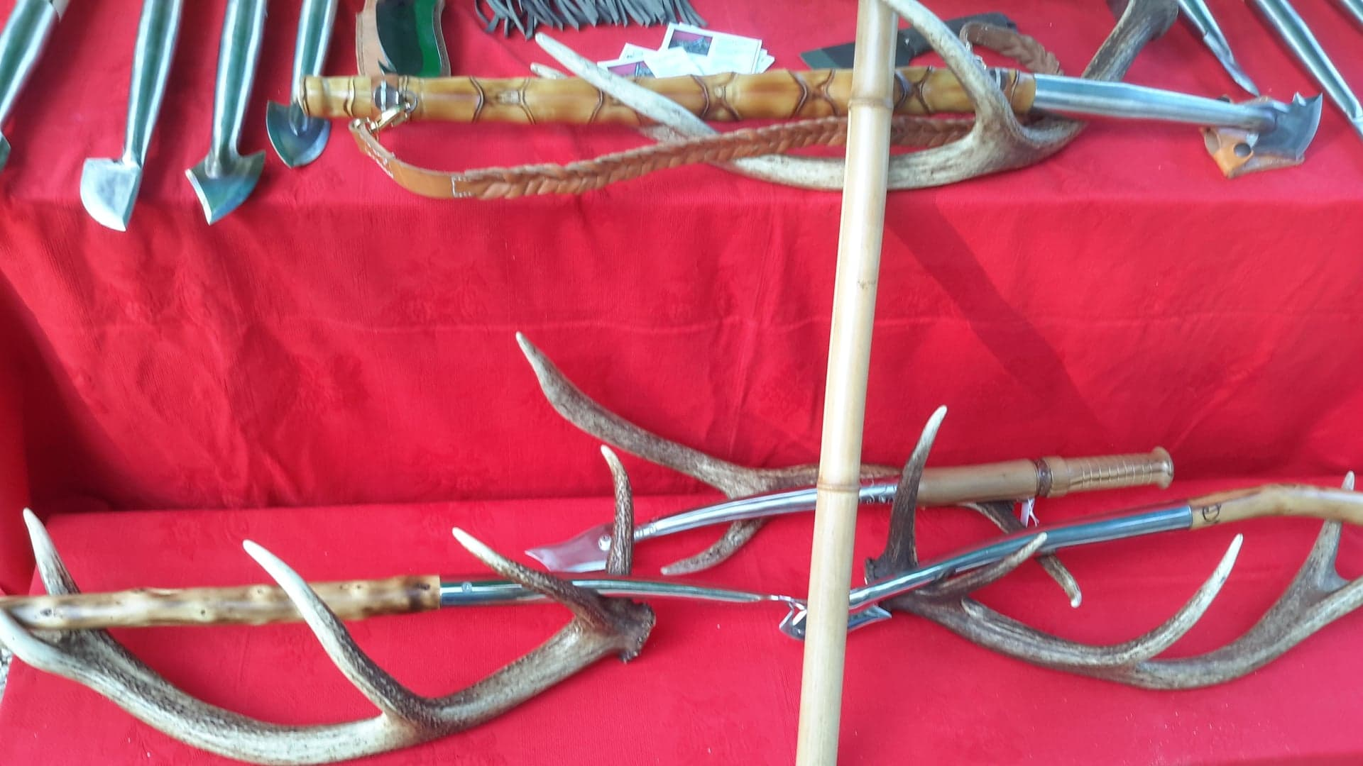

Slide 22
Truffle dog to recognized breed
“Truffle hunters have always bred their dogs on an entirely empirical basis (outside of any genetic rules), taking into account only the immediate, practical outcome: a brilliant truffling dog, whether Lagotto Romagnolo or not….. However, merit where merit is due: the truffle hunters of that period did not let our Lagotto Romagnolo fall by the wayside, allowing it to survive—almost by miracle—to the present day in near-perfect phenotype and genotype form.
“Toward the mid 1970s a group of Romagna based dog lovers decided to save the breed, which was risking extinction as a result of the incompetence, ignorance and negligence of owners…..” Dr. Giovanni Morsiani, The Lagotto Romagnolo: Short history of the breed and current situation
Notes:
A little background for the attendees to take home.

Slide 23
Modern History
1920s The truffle dog was bred for its ability to hunt truffles, on an entirely empirical basis—the best truffle hunting dogs –whether lagotto romagnolo or not—bred together.
1970s A group of Romagna-based dog lovers decided to save the breed from extinction.
1988 Club Italiano Lagotto (C.I.L.) was formed
1992 first standard was written, based on years of biometric measurements on hundreds of dogs, breed approved by ENCI (Italian Kennel Club).
1995 acceptance into the FCI
2000 AKC FSS status, 2007 companion events eligible and parent club formed, 2013 enters the Miscellaneous Class
Full AKC Recognition in July 2015
Notes:
We have been a recognized breed with a standard for only 28 years!

Slide 24
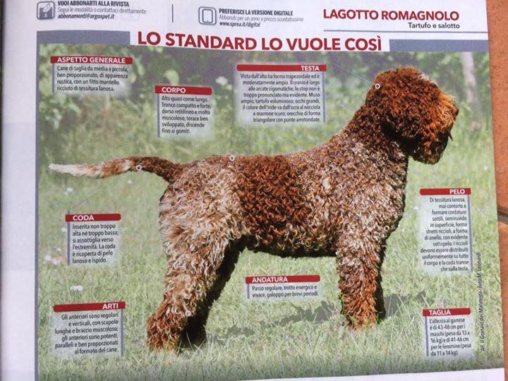
General Appearance
Small to medium-sized dog, well proportioned,
powerfully built, of a rustic appearance, with
a dense, curly coat of woolly texture. The dog should give the impression that he has the strength and endurance to work all day in difficult and challenging terrain.

Slide 25
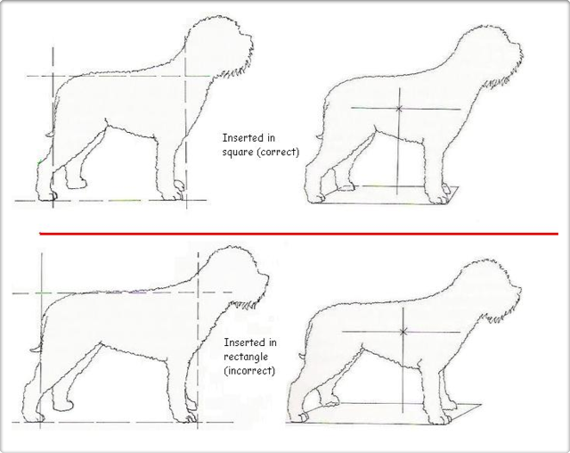
Important Proportions Overall Shape

Slide 26
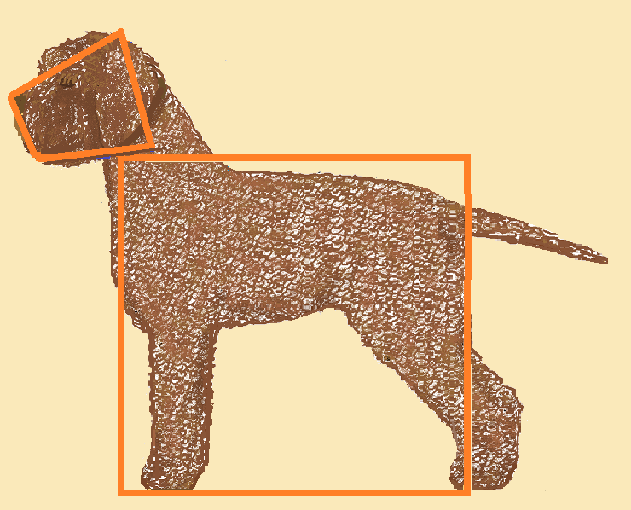
A Lagotto is a wedge over a square

Slide 27
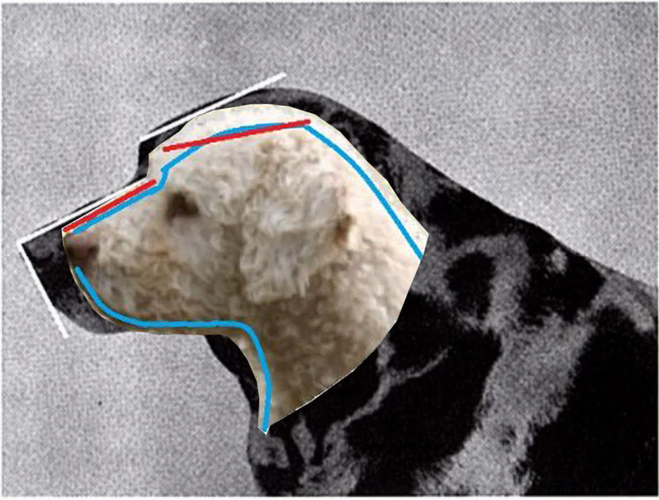
Comparison of Retriever head to Lagotto
Labrador Retriever : Parallel planes and 50/50 skull to muzzle proportions. Ability to easily pick up large birds.
Lagotto Romagnolo: Slightly divergent head planes and 54/46 Skull to muzzle proportions. Muzzle is shorter and wider to help get scent information to the dog’s brain faster.
Notes:
Labrador Retriever with parallel planes and 50/50 skull to head proportions. Lagotto with slightly divergent planes and 54/46 skull to head proportions

Slide 28
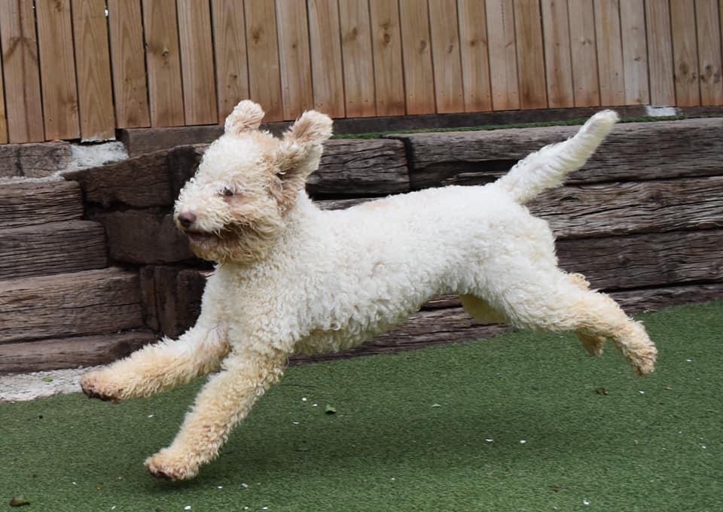
Need to stretch your legs?

Slide 29
HALLMARKS OF THE LAGOTTO ROMAGNOLO
PART TWO:

Slide 30
Breed Hallmarks
After breed conformation judging in Italy, dogs are then judged on 3 key components in the breed:
Head Type
Quality of the Coat
Movement and Structure.

Slide 31
Head Type: a defining breed characteristic
Strong male head with good proportions
Female head
The head is the most changed feature of the dog moving from his first career as a retriever to his second career as a master of scenting and searching.

Slide 32
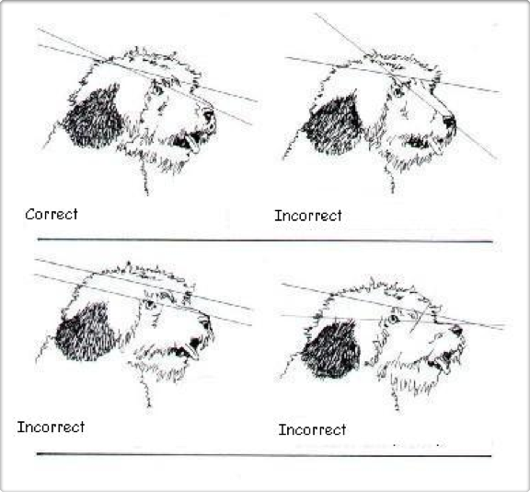
Important Proportions Head Planes
Incorrect:
Roman Nose
Parallel Planes
Dish Faced

Slide 33
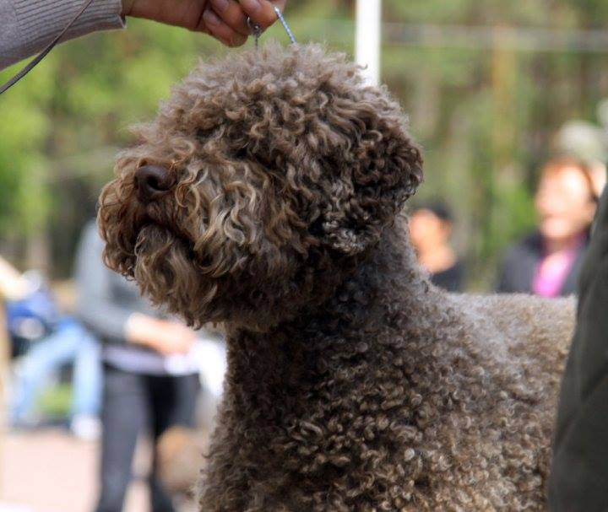
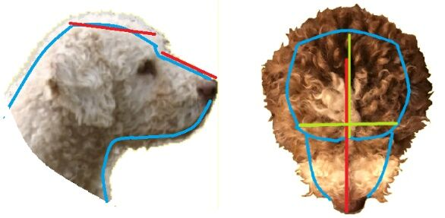
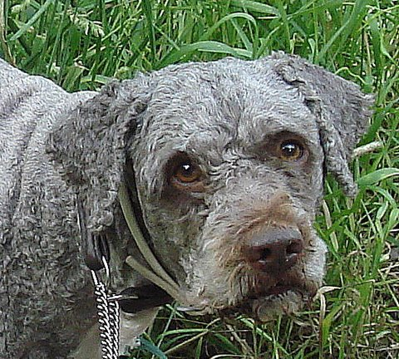
Strong under jaw
Head:
Skull Broad
Planes slightly divergent, , moderate stop
Broad wedge muzzle, shorter than skull
Medium triangular ear set on just above eye

Slide 34
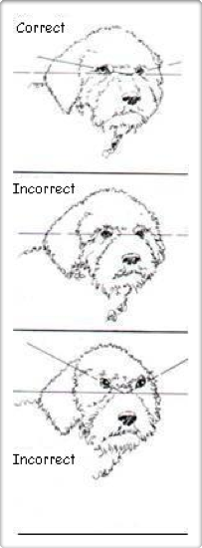
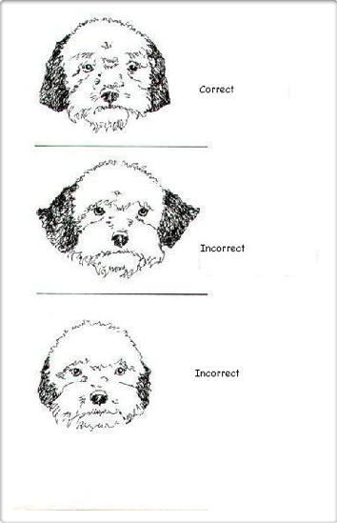
Important Proportions Eyes and Ears

Slide 35
Bite and Dentition
3 Bites are acceptable:
Scissor
Level
Reverse Scissor is acceptable
Dentition: Full Dentition is preferred.
A FULL MOUTH EXAM IS NO LONGER REQUIRED.
(Bite and side only)

Slide 36
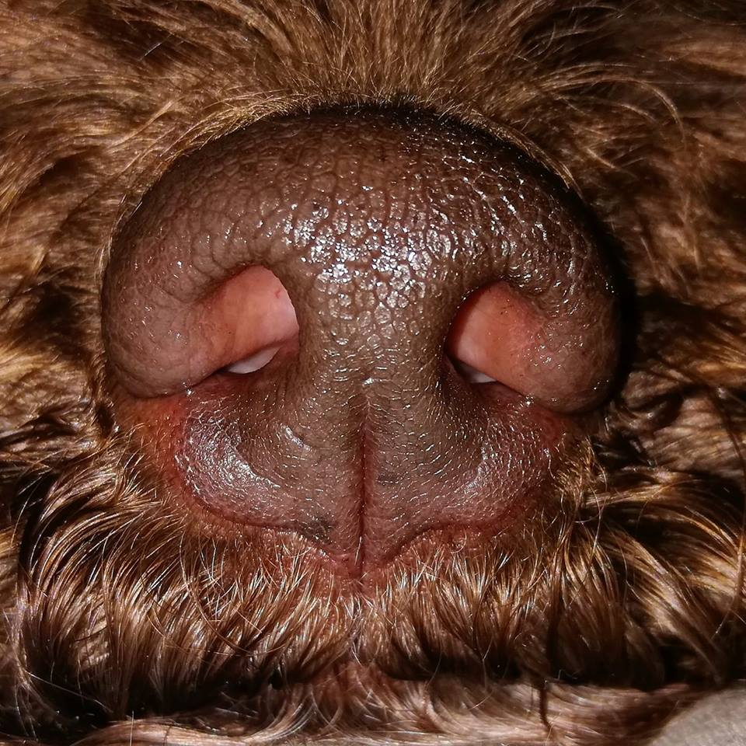
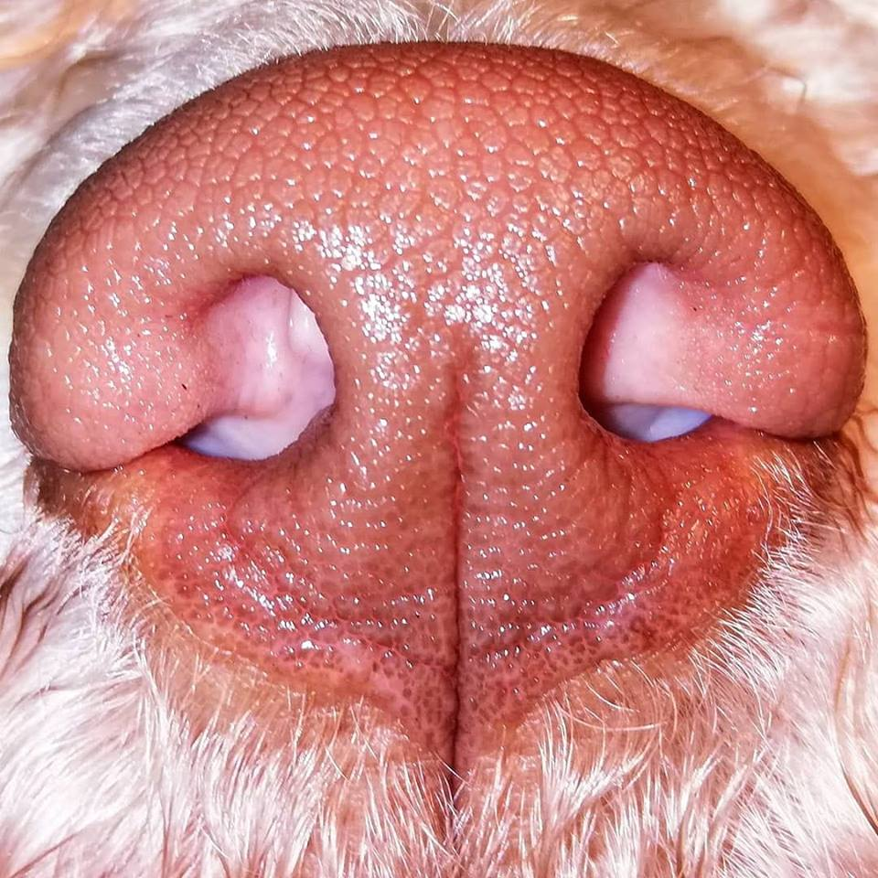
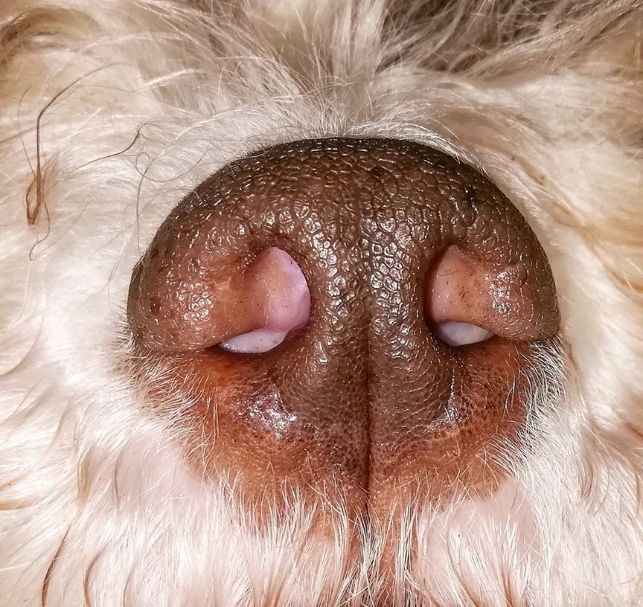
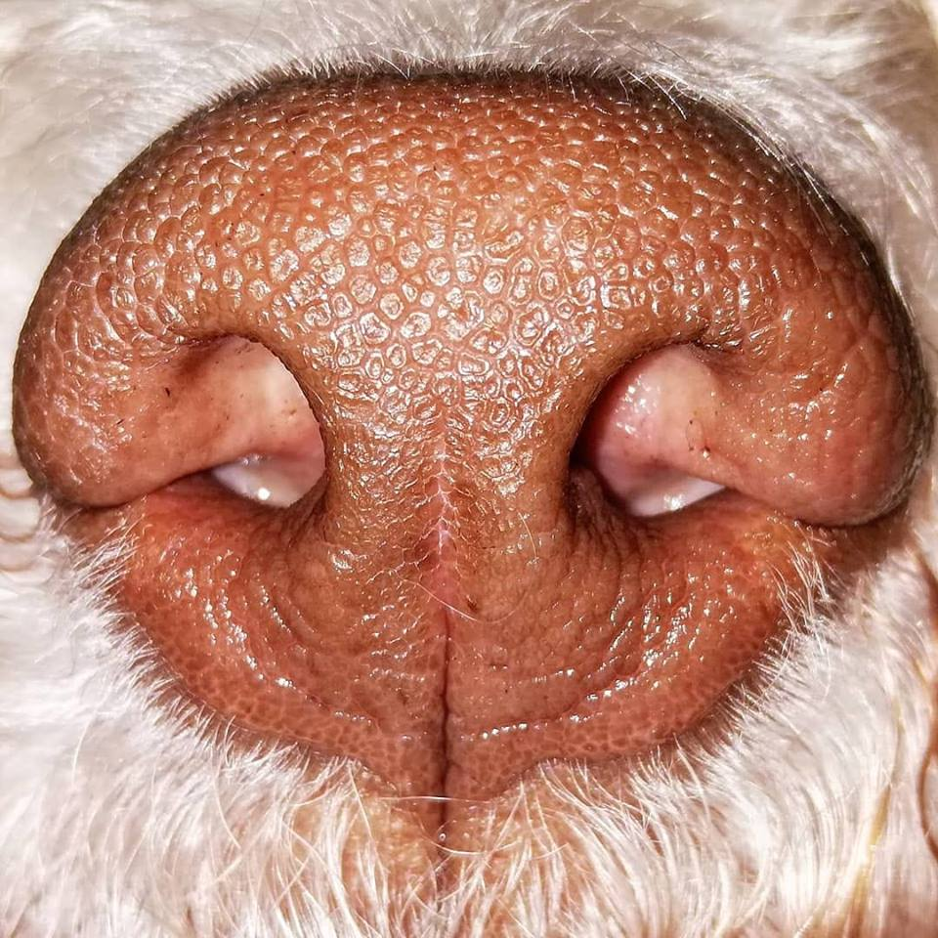
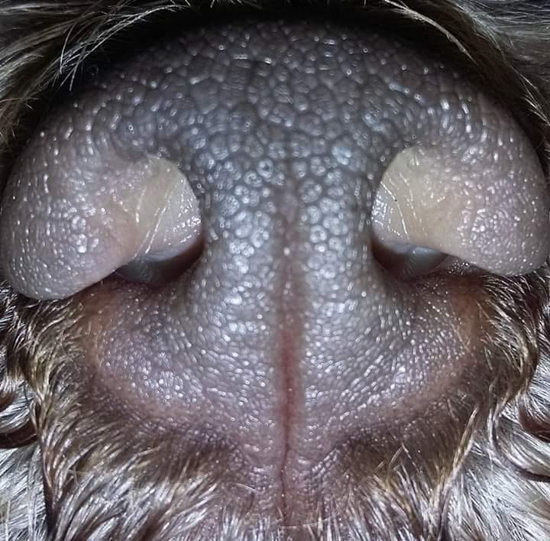
Nose pigmentation
NOT FULLY PIGMENTED

Slide 37
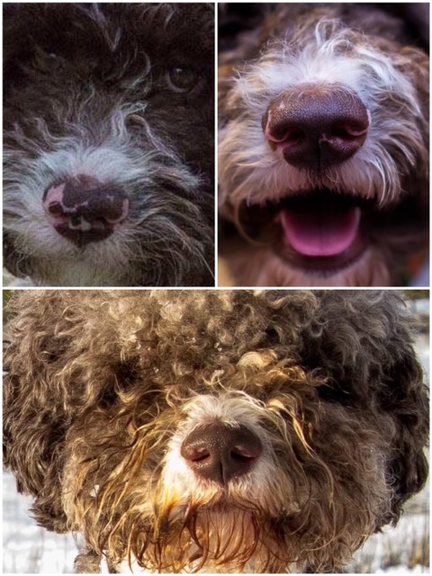
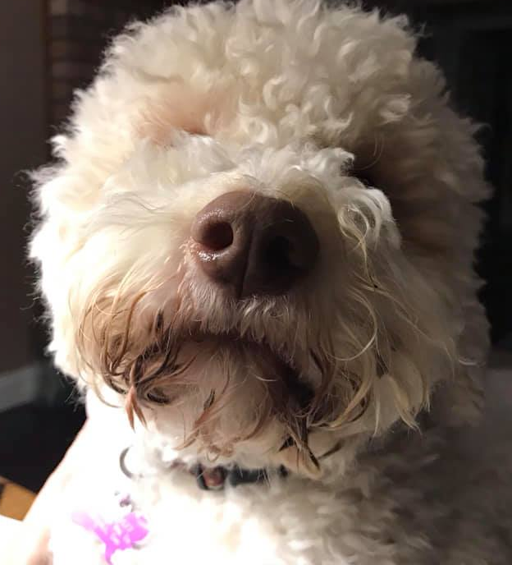
Non – pigmented nose from puppy to Adult
Beautiful brown pigment on a white dog

Slide 38
HEAD DQS
HEAD FAULTS
Incorrect proportions
Pigment: Lack of pigment on nose
Pigment: Lack of pigment around eye rims.
Incorrect planes of head, dish faced or roman nose
High or low set ears
Eyes not set obliquely, not round
Bite: Overshot or Pronounced Undershot, (incisors of the upper jaw not touching)
Pigment: Black nose or pigment

Slide 39
“Examining the head needs “hands on” as a skillful clip could visually give the appearance of a correct head which might be an illusion and [the dog might] actually have a narrow skull and a long narrow muzzle, unfortunately faults that are quite common in the breed…
“…the muzzle with its blunt profile is not square but like a triangle with a cut corner….the nose should be obvious and big….
“…this type of muzzle often has a pincer bite (level) or a reversed scissor bite; both types are permissible in the lagotto as is the regular scissor bite. The message is that with this type of muzzle an overshot bite is completely untypical….” Reneē Sporre-Willes, Illustrated Breed Compendium for Lagotto Romagnolo
LET’S TAKE A LOOK AT A REAL DOG AND HOW YOU MIGHT EXAMINE THE HEAD

Slide 40
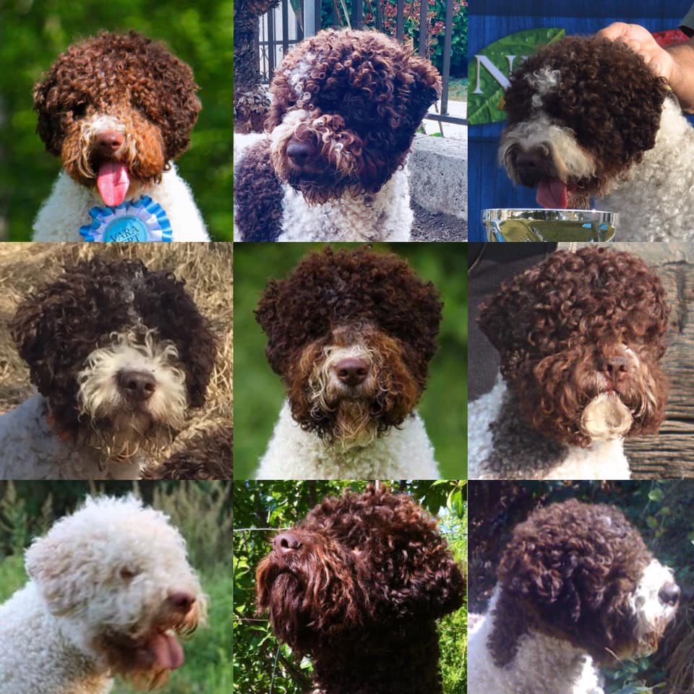
Notes:
Assortment of male heads of a variety of ages to take a look at. Which are your favorites and why

Slide 41
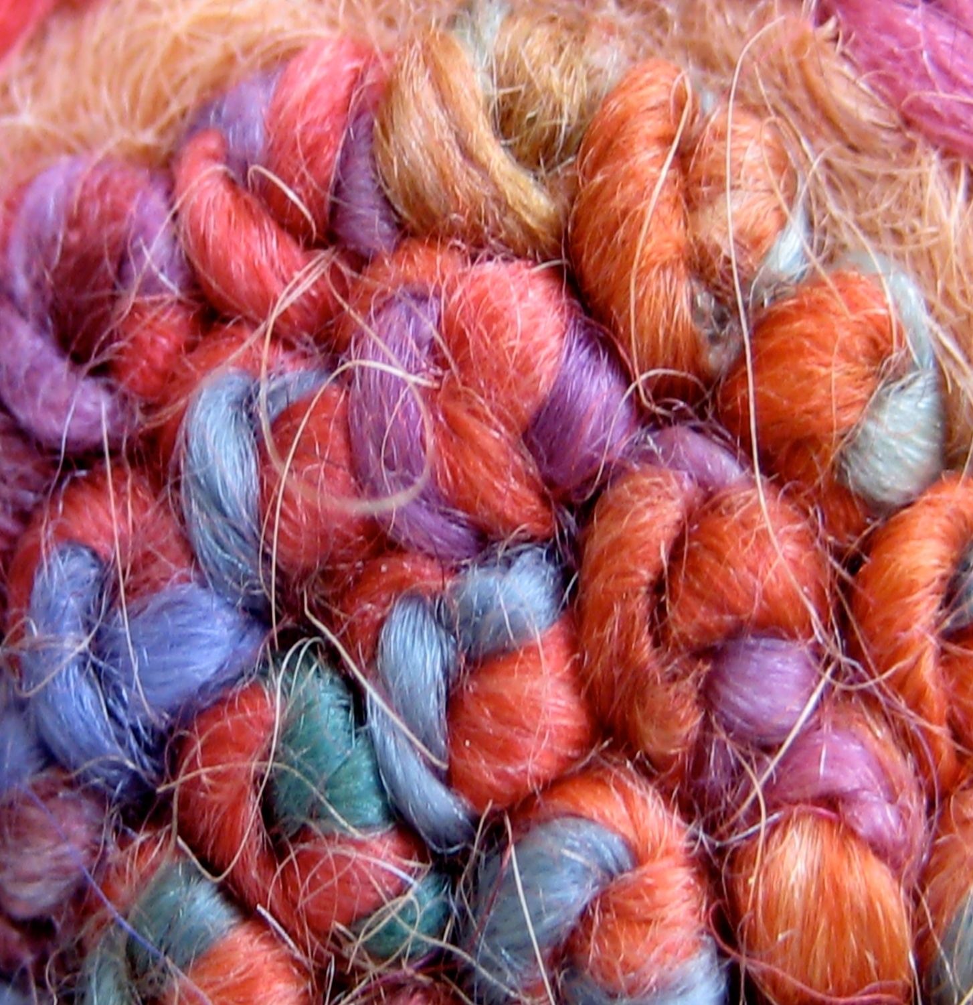
Coat: A hallmark of the breed
Nubby, French Knots
Correct curl

Slide 42
COAT AND CURL
A defining feature of the breed
Hair - of woolly texture, never twisted to form thin cords, semi-rough on the surface, with tight, ring shaped curls, with visible undercoat. Curls must be evenly distributed all over the body and tail, except on the head, where the curls are not as tight. A dense undercoat and curls must be present in order to evaluate coat quality.
Colors - All colors except Black

Slide 43
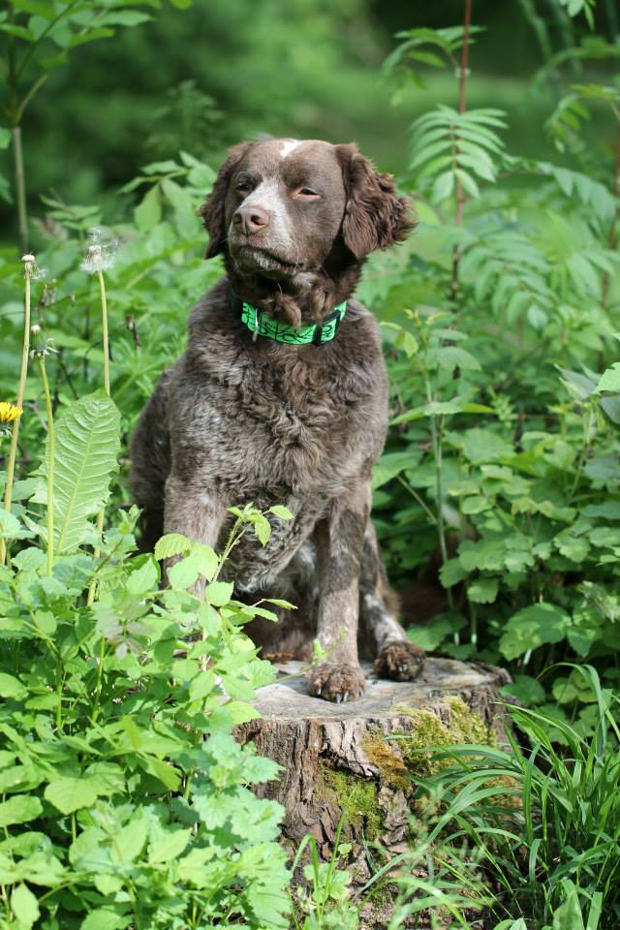
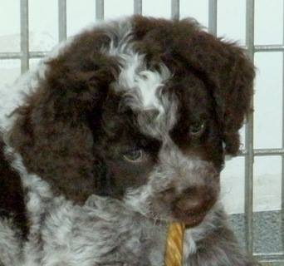
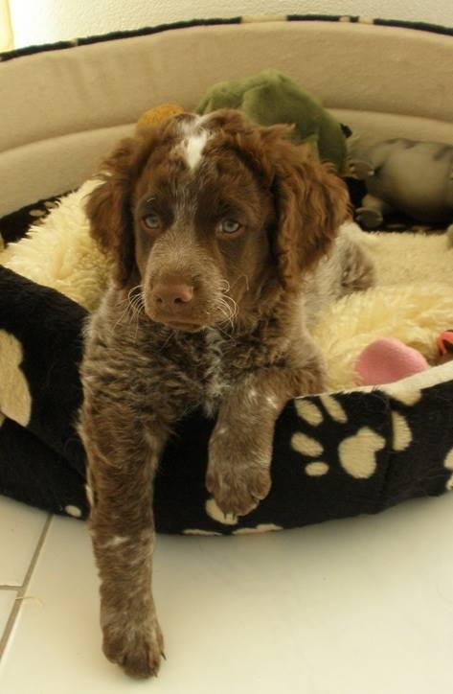
Genetic Coat faults
Incorrect Coat is a genetic condition in which the dog lacks both curl and furnishings
Notes:
This is a dog who is IC affected. The noticeable difference is evident in the far right photo (between 8-10 weeks old) These slides are all the same dog. This is an entirely cosmetic fault, causing no discomfort or problem to the dog in its lifetime. However, it is a DQ fault.

Slide 44
COAT ASPECTS:
CURL:
Complete rings of curl, never merely wavy
TEXTURE:
Wooly
Thick
Difficult to part and see skin

Slide 45
Even from across the ring, you should see the silhouette of the dog COVERED in nubby, articulated curls. They resemble French knots.
The dog’s coat should never appear blown out with curls at only the edges of the coat, like a “Chia Pet.”

Slide 46
The correct clip is un-pretentious and contributes to accentuate the natural, rustic look typical of the breed. The correct coat is never luxurious and shiny. Corded or excessively groomed dogs (sculpted or blown out so that the curl may not be assessed) should be so severely penalized as to eliminate from competition. --AKC Breed Standard

Slide 47
Coat Colors
Notes:
Top Row: L-R White/Orange, Bottom Row: Patch (White/Brown) Brown, Roan. Previous page Brown and Tan.

Slide 48
Fading
Brown and Tan Adult
Brown and tan adult
Brown and tan puppy
What color am I?
The colors have a tendency to fade to a more diluted shade as the dog ages, sometimes to such an extent that the brown areas can appear as a silvery/gray roan. All colors are equally desirable including faded or diluted colors.-- AKC Standard
Notes:
.

Slide 49
Drastic changes
Notes:
Top is the same dog Roan Brown and Tan in both photos about 10 months apart. Bottom is a Sable and White patch. Note the dark pigment on nose around eyes and on the ear tips, as if the dog were brown. Dark hair here is NOT a fault and should not be confused with black or grey.

Slide 50
This is NOT Gray!
Hint: Look for a black nose! Lagotto with brown noses are NOT genetically gray, however much
they may seem to be frosted, faded or intermingled with white hair.
Notes:
After talking with our European counterparts, it has been determined that the only way to have actual “grey” genetically would be for the dog to have a BLACK NOSE.

Slide 51
CLOSE UP OF BROWN ROAN HAIR NOTICE THE VARIETY OF COLORS THAT MAKE UP TH E COLOR.

Slide 52
COAT FAULTS
Coat is wavy, not curly
Coat is over groomed or sculpted
Hair is too short to curl
Any black or gray in the coat (DQ)
Can be the fault of the groomer!
Let’s take a look at some curls.
Notes:
Dog goes on the table again for a look at real curls with participants

Slide 53
Movement and Structure
Gait/Movement
Energetic trot with moderate reach and drive
Lively and balanced
Always shown at a moderate trot

Slide 54
Important Features Body Shape and Topline

Slide 55
Some thoughts about Movement
“You should see the Lagotto moving.…NOT the Lagotto’s HAIR moving.”
-Monica Benelli, Il Granaio Dei Malatesta Kennel, Italy
“The gait of the Lagotto is characterized by the loose and cheerful trot that reflects the deep, deep joy in performing his function. This is not a hunting dog, and he doesn’t need to run after animals, he doesn’t need to run anywhere---the speed is not his purpose, rather instead a diligent search for truffles.”
-Sabina Zdunic Sinkovic, Kan Trace Kennels, Croatia

Slide 56
At a walk, the dog’s legs are parallel and never wider than the dog’s shoulder
At increased speed, the legs converge and the neck moves slightly lower and forward
He does not over reach
He does not single track
He should never be shown in an elongated trot
Notes:
At the walk the dogs legs are parallel, as speed increases they converge toward the center. They do not single track, however. Nor do they over reach with the rear foot passing the footprint of the front foot. As they increase in speed the neck moves slightly lower and forward. He should not be exhibited in an elongated trot—it is atypical and incorrect for the breed.

Slide 57
Measured from prosternum to ischium and from wither to floor
Elbow directly below rear edge of scapula
Body depth (wither to elbow is 44%;
Leg (elbow to ground is 56% of total height
Head slightly longer than neck
SIZE AND SUBSTANCE:
Males: 16.5-19.5 inches
Females 15.5-18.5 inches
Males 28-35 pounds
Females 24-31 pounds
MODERATE BONE

Slide 58
Notes:
Shoulder angle should read 115 degrees. Rear angulation is 110 degrees.

Slide 59
Pronounced wither
Straight Back
Slightly sloping croup
Loin as wide as it is long
Foreleg vertical, pasterns slightly sloping.
Rear pastern vertical

Slide 60
Tail Set
Notes:
It goes without saying that the tail in the photograph is set and carried incorrectly. Examples in the drawing are of a dog who is STANDING.

Slide 61
Tail carriage
”In my opinion, one thing of fundamental importance is that the characteristics of the rump are respected and therefore that this is long and inclined at 25 ° / 30 °. If the croup is correct, the tail cannot be inserted high and therefore it cannot be carried on the back, but it can be carried, correctly, over the line of the back.
The following is an image that wants to illustrate various types of carriage, indicating the correct ones and the wrong ones:
From Considerations on the bearing of the Lagotto Romagnolo's tail
by Andrea Langianni illustration by Laura Tanos. Published on the Club Italiano Lagotto website.
Notes:
The

Slide 62
Common Structural Faults
Rectangular
Too short on leg
Cowhocked
Not enough turn of stifle
Too much substance/heavy boned
Too short through the croup
Too flat through the croup
Gay tail

Slide 63
Style within Type
Slightly more short coupled, heavier bodied. Fabulous coat.
Slightly more elegant, with more neck and a lighter frame. Also Fabulous coat perhaps more than necessary.
Notes:
Both dogs are correct! Both are square with plenty of leg, good proportions to the head, fabulous coat. Dog on the left is more round in cross section, while dog on the right is more oviod.

Slide 64
Behavior and Temperament
Behavior and Temperament
The Lagotto is tractable, keen, affectionate, very attached to his owner and easy to train. He is also a very good companion and an excellent watch-dog.
Notes:
“Undemanding” is the word that gives Lagotto owners a good laugh. What is meant is “easy keeper”, “adaptable”, not high maintenance in the sense of food and care…..a word that does not translate well into English!

Slide 66
Standard Summary
BODY- Square in structure
Head- Cranial region should be nearly as wide as long (square)
The muzzle is broad in width, in length a little shorter than the skull (44% to 56% ratio). The muzzle is wedge shaped, giving a blunt profile.
Nose and Nostrils- Should be large and open.
Chest - well developed, reaching down to the elbows.
Ribs - well developed, narrow in front; widening from the sixth rib back (behind the shoulders) to the last rib.
The Topline - well pronounced withers, topline straight from behind the withers to the
croup, which is slightly sloping.
Body - compact and strong.
Croup - long, wide, muscular, slightly sloping.
Tail - set on slightly below the line of the
back; following the natural line of the croup. The length of the tail when hanging at rest
should barely reach the hocks.
Beginning January 1, 2017 Lagotto Romagnolo is a “ramp optional” breed!

Slide 67
SUMMARY
DEFINING FEATURES OF THE BREED
HEAD SHAPE THAT FEATURES A SHORT, BROAD MUZZLE IN ORDER TO CREATE THE WIDEST POSSIBLE NASAL PASSAGES
DENSE, CURLY, WATER-RESISTANT COAT
SQUARE IN STRUCTURE, CONSTRUCTION THAT ALLOWS EFFICIENT, LIVELY MOVEMENT
TEMPERAMENT AND ENERGY TO WORK ALL DAY

Slide 68
More information
Lagotto Romagnolo Club of America www.lagottous.com
Breed mentors:
Sandy Mignogna (PA)
Adrienne Perry (AL)
Lisa Sobon (CA)
Judith Tyler Martin (CA)
Richard Mullen (TN)
Christine Mullen (TN)
Carolyn Talbert (VA)

Slide 69
Additional Resources
The Illustrated Breed Compendium for Lagotto Romagnolo (also called the Romagna Water Dog) by Renee Sporre-Willes. Can be read at: www.cobbys.se/
America Welcomes the Lagotto Romagnolo by Adrienne Perry. Originally published in August 2015 edition of Dogs in Review. Can be read at: http://www.dogchannel.com/dogsinreview/introduction-to-the-lagotto-romagnolo.aspx
www.Lagottoromagnolo.org The webpage for the Club Italiano Lagotto has a wonderful archive of articles that you can read.

